Slide 1
SAP EWM EXTENDED WAREHOUSE MANAGEMENT TRAINING
AnubhavTrainings.com
www.anubhavtrainings.com

Slide 2

SAP EWM TRAINING
BY:-
Mr. Bijoy
www.anubhavtrainings.com
Notes:
https://unsplash.com/photos/uXB-7la5vqA

Slide 3
Process Code in EWM& Exception Codes
Process code and exception code
Batch selection criteria for Outbound process
Testing of Outbound process with batch selection criteria method
Exception code concept in EWM and Configuration & testing of exception codes

Slide 4
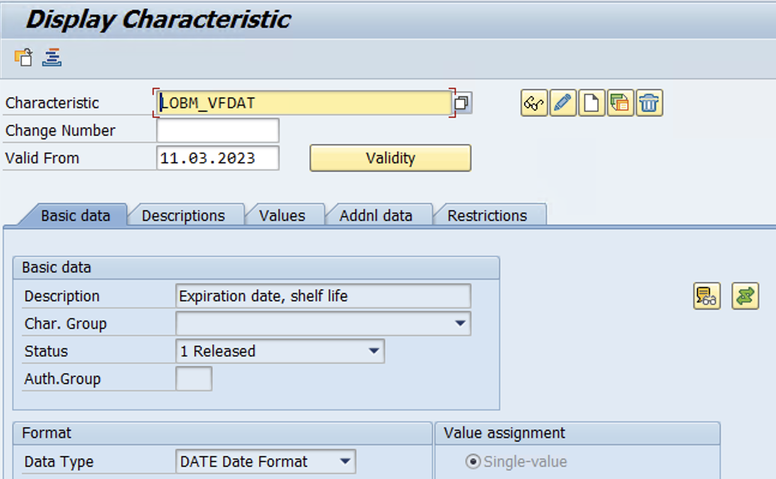
Batch Management
Configuration
Create Characteristics (Tcode – CT04)
Use Standard Characteristics for Remaining shelf life for Batch
LOBM_VFDAT, LOBM_RLZ & LOBM_LFDAT
www.anubhavtrainings.com

Slide 5
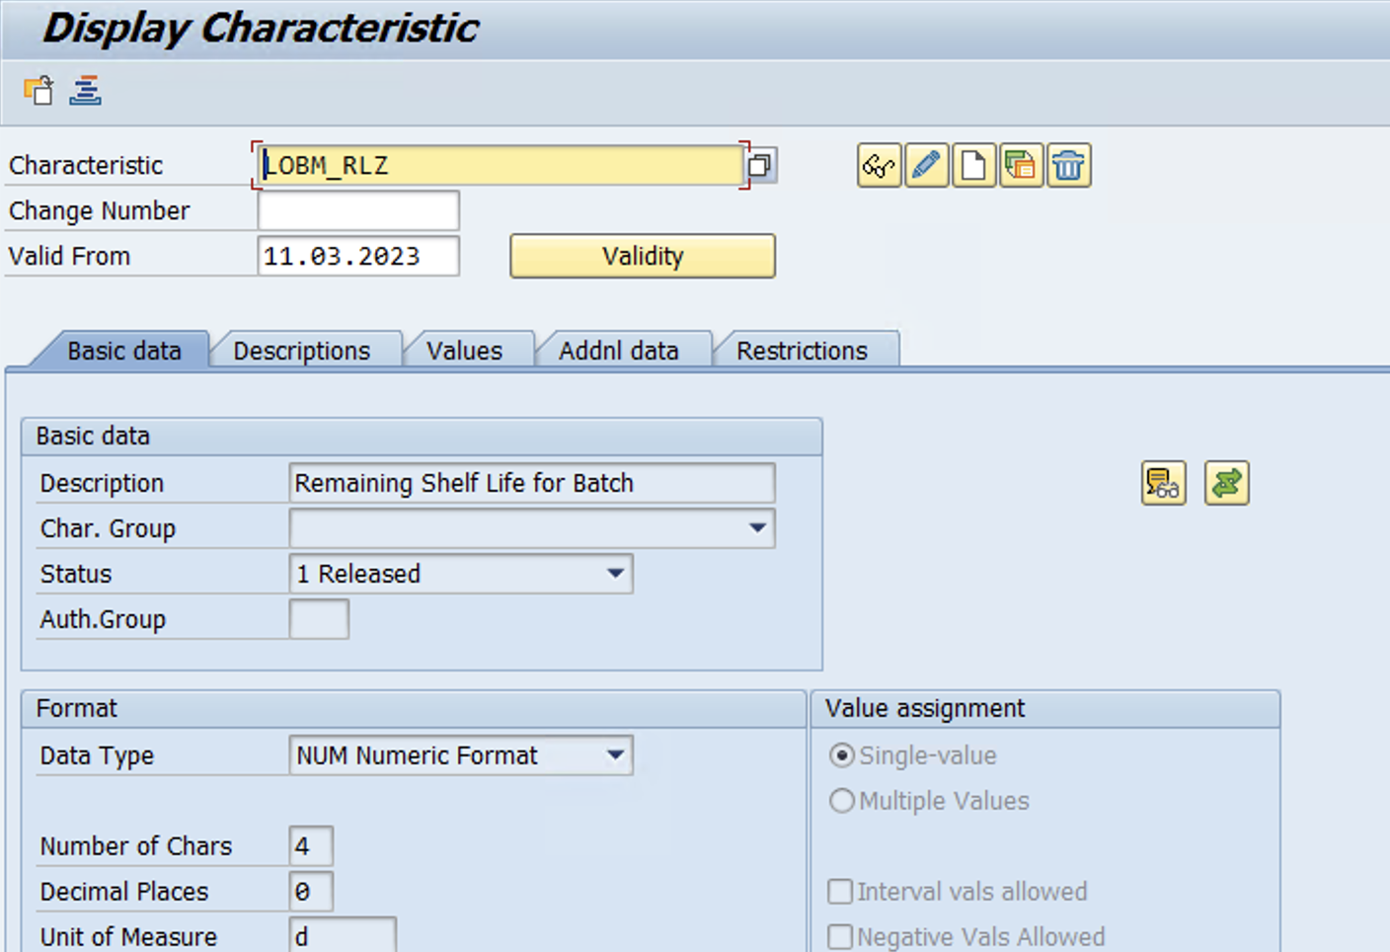
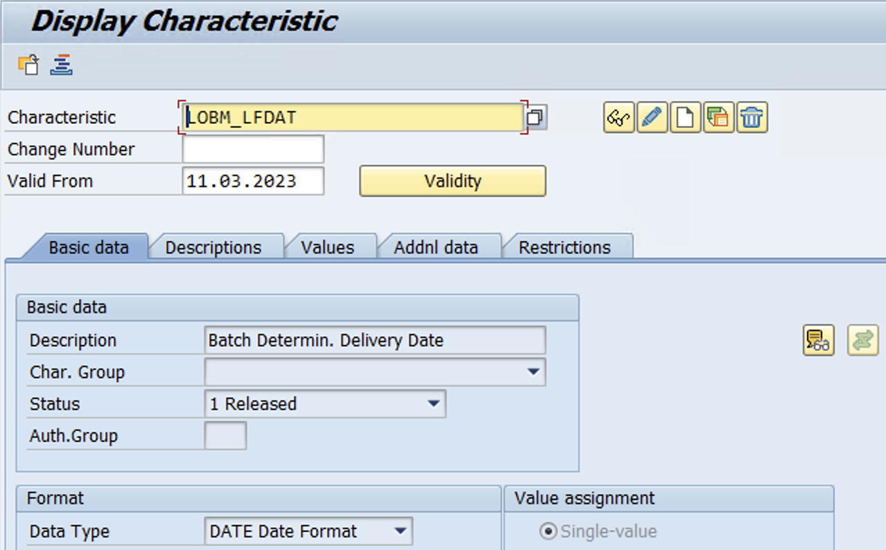
www.anubhavtrainings.com

Slide 6
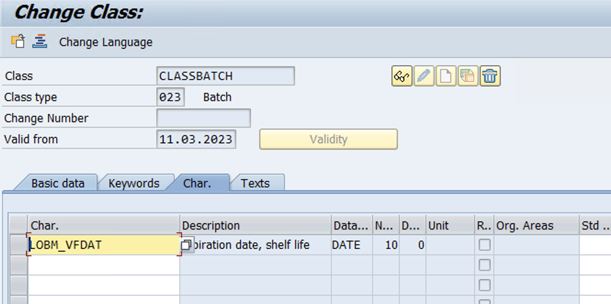
Create Class (Tcode – CL01)
www.anubhavtrainings.com

Slide 7
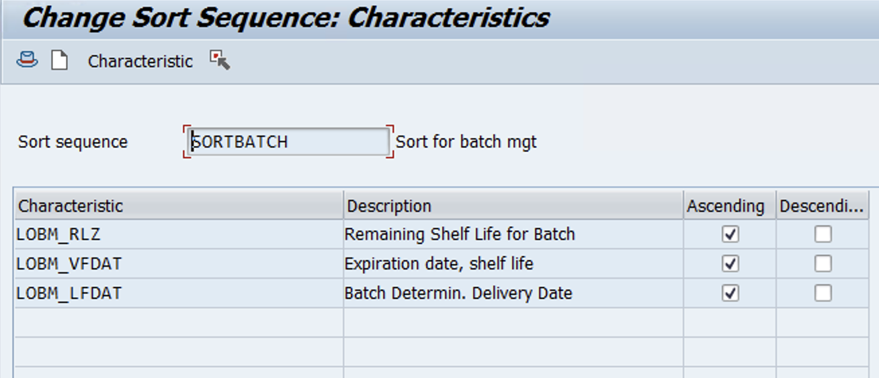
Create Sort Sequence (Tcode – CU70)
www.anubhavtrainings.com

Slide 8
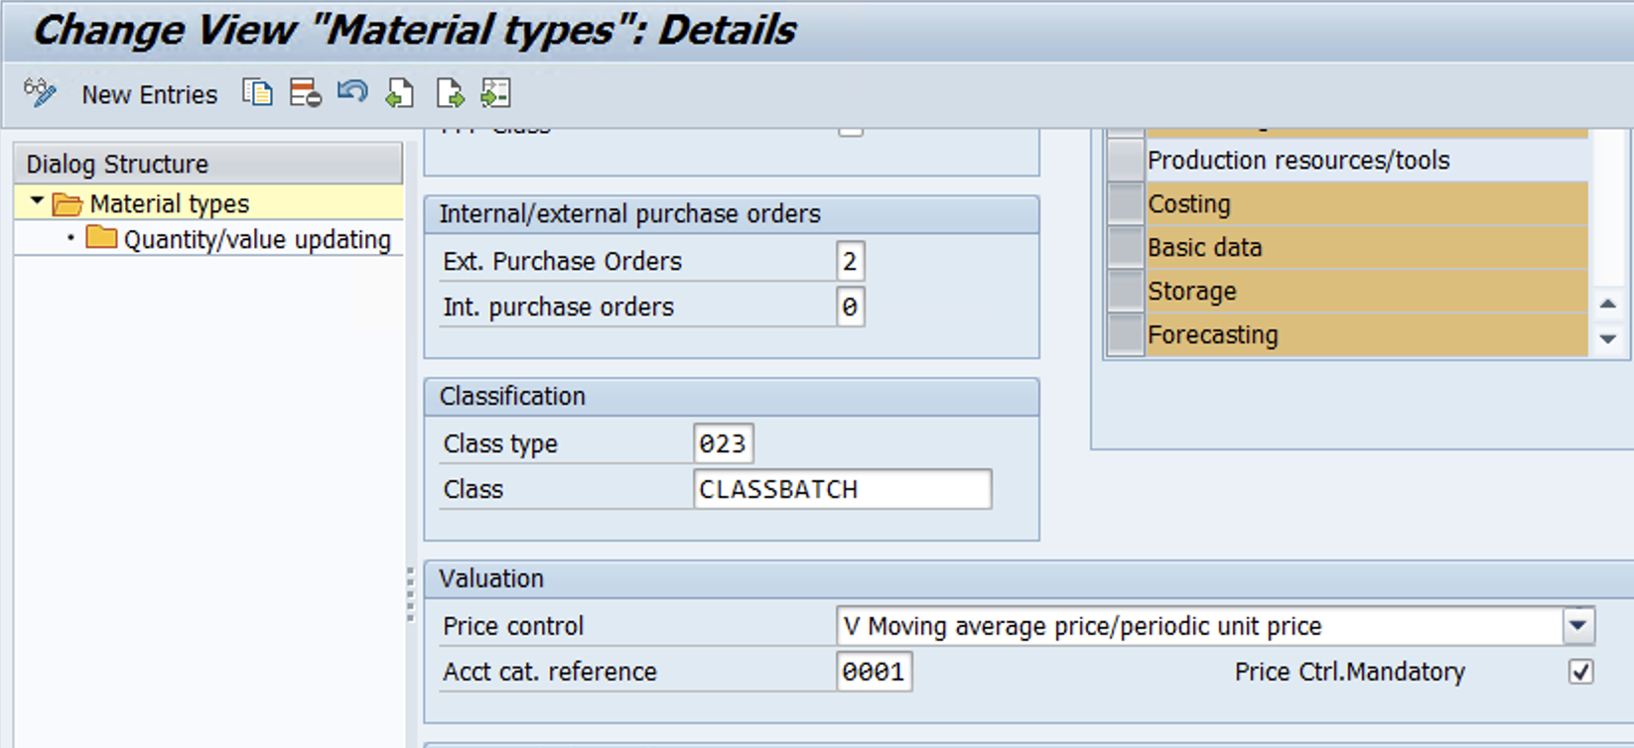
Update Class & Class type in tcode – OMS2
www.anubhavtrainings.com

Slide 9
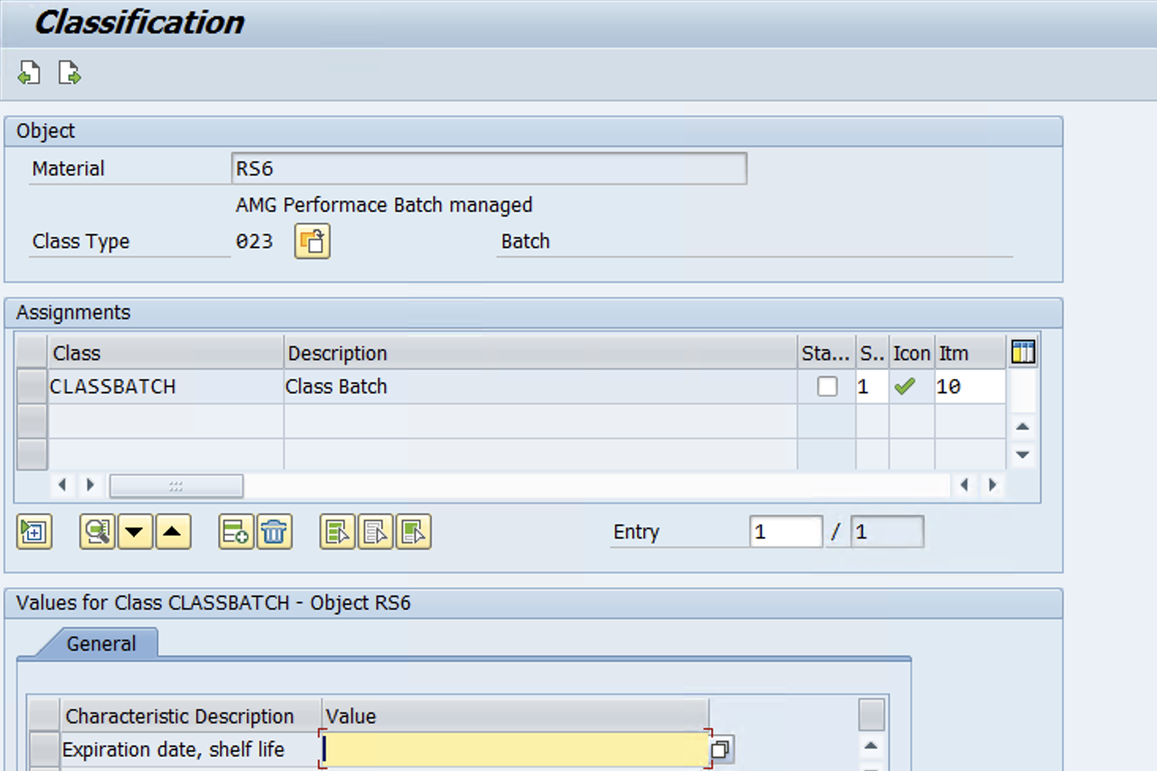
Maintain Material Master with Classification data & Activate Batch management at Purchasing level -

Slide 10
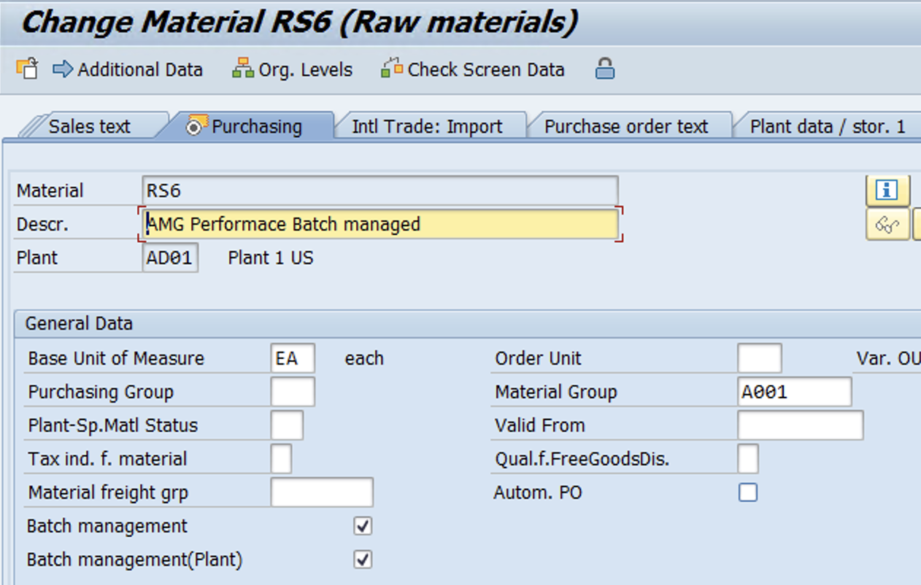
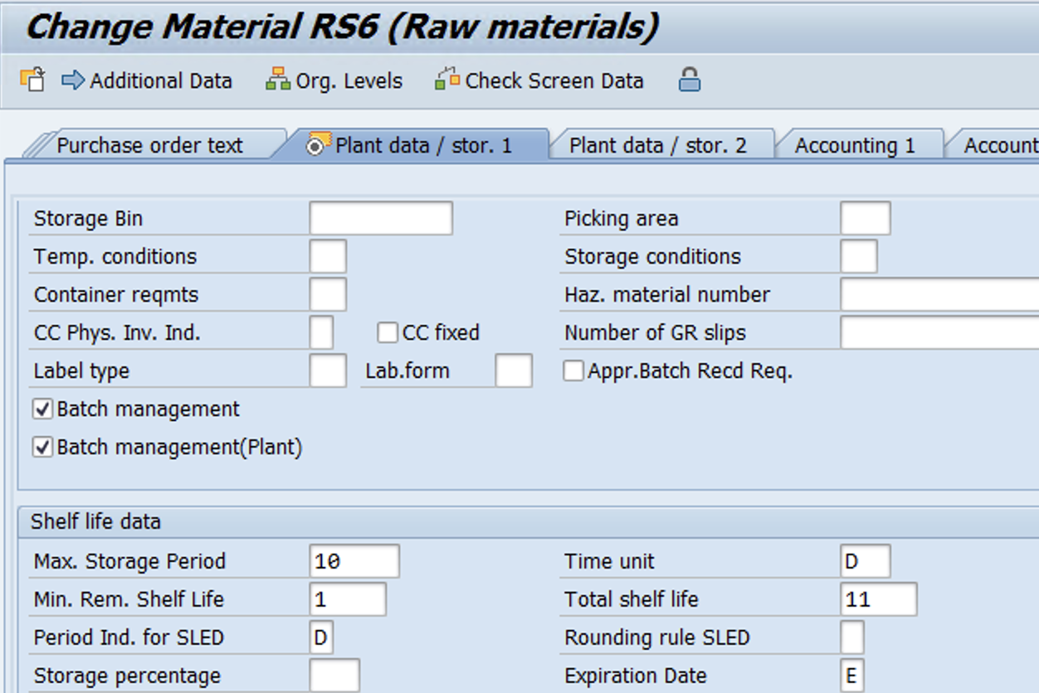

Slide 11
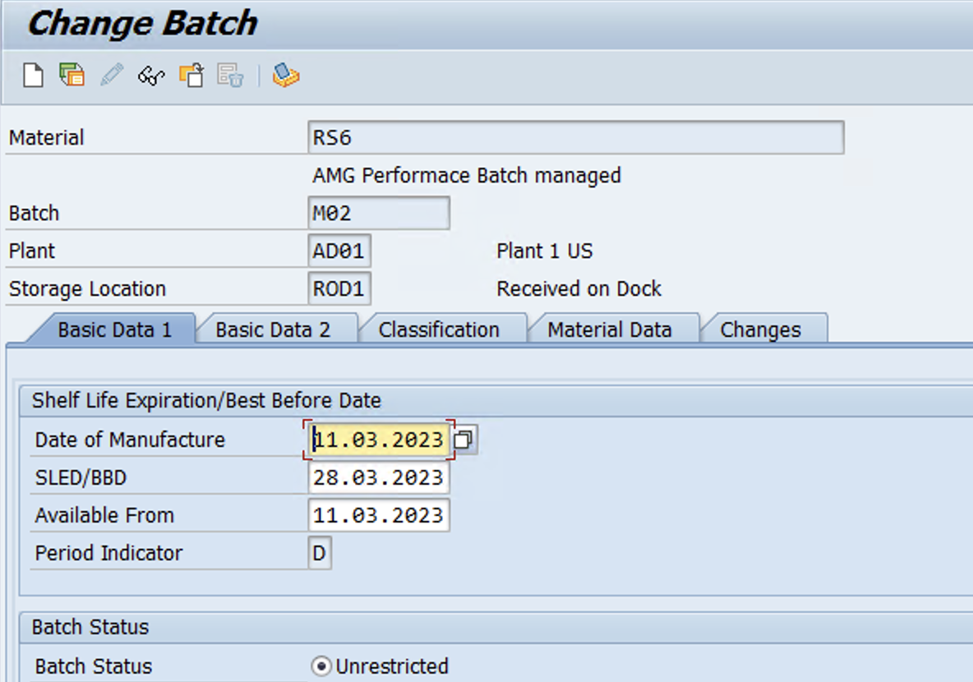
Create Batch using tcode – MSC1n
Please Note – SLED date has been changed manually for testing purposes!!

Slide 12
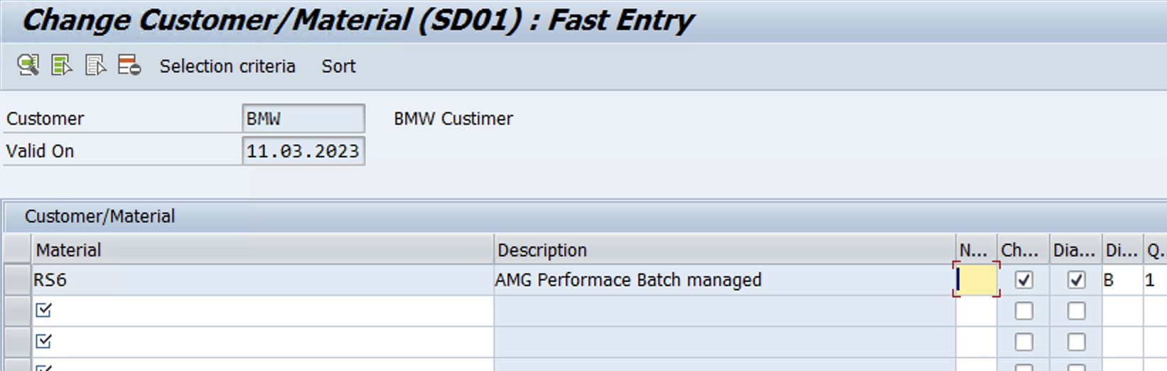
Maintain Customer/Material condition record in Tcode – VCH1
Selection Criteria
www.anubhavtrainings.com

Slide 13
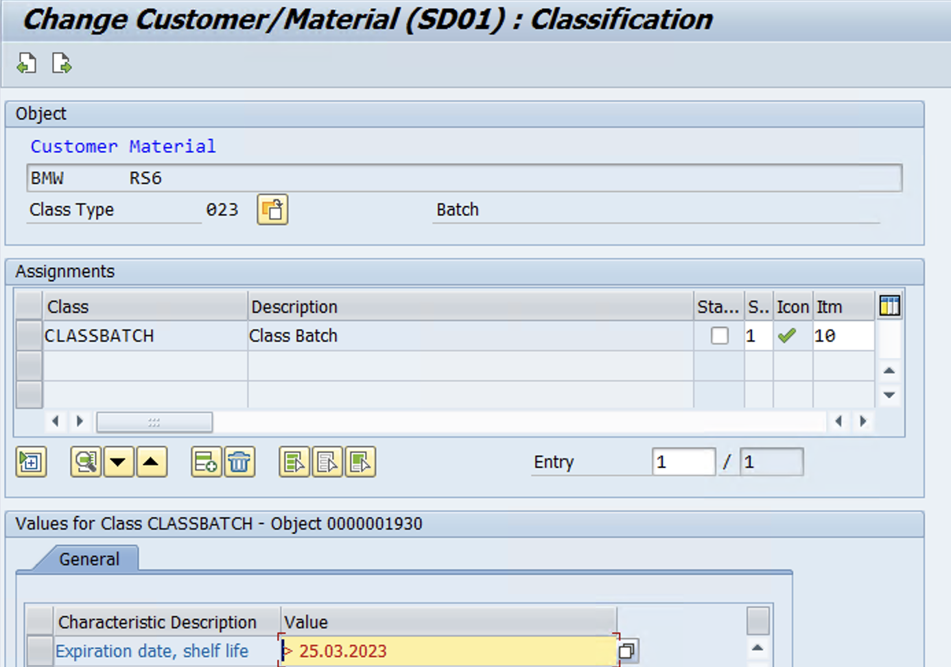
www.anubhavtrainings.com

Slide 14
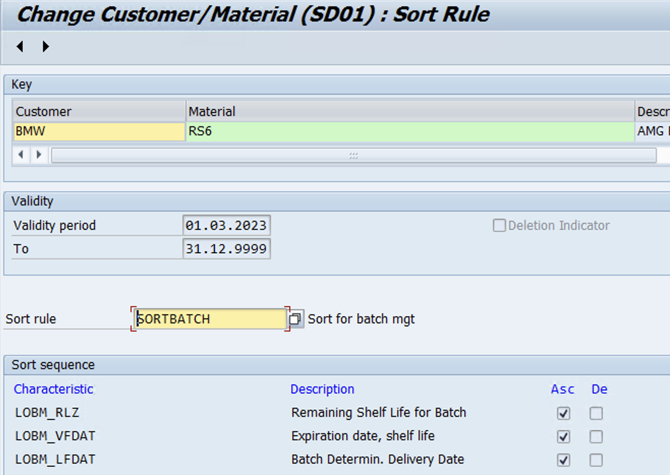
Sort
www.anubhavtrainings.com

Slide 15
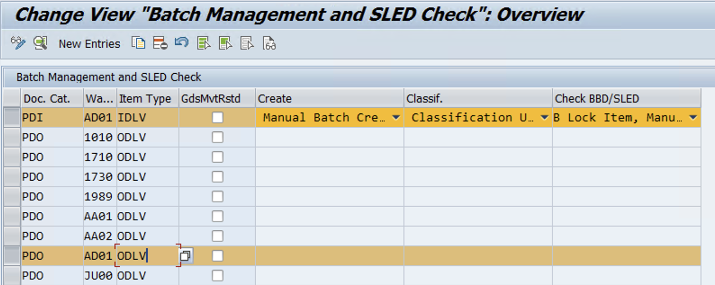
EWM Configuration
IMG > EWM > Cross-process setting > Batch Management > Define setting for delivery - Warehouse request
www.anubhavtrainings.com

Slide 16
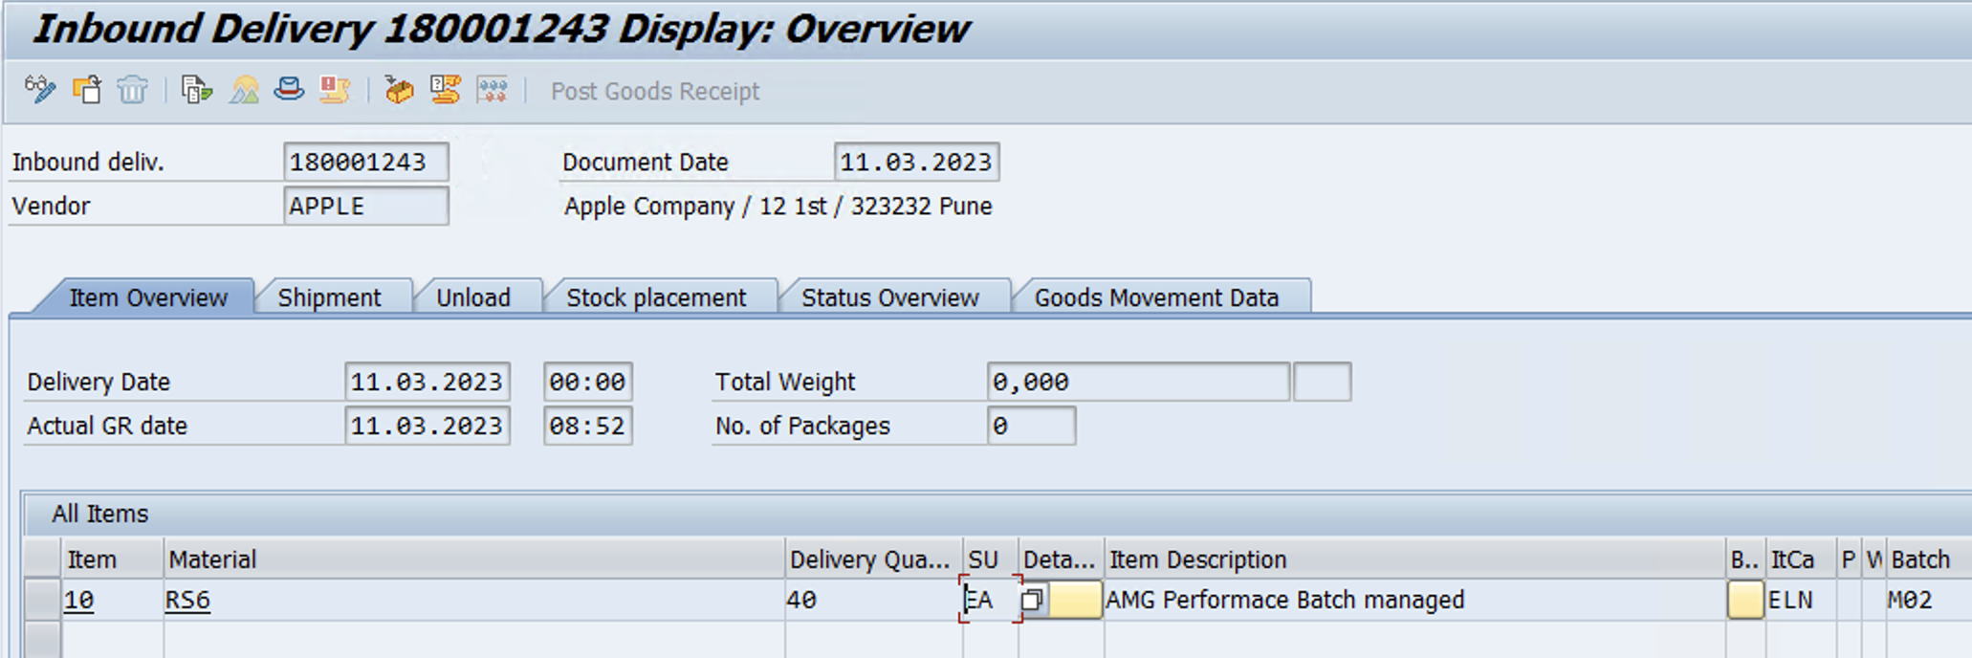
Test Case (Inbound)
Create PO > IBD (Enter Batch no while processing IBD)
www.anubhavtrainings.com

Slide 17
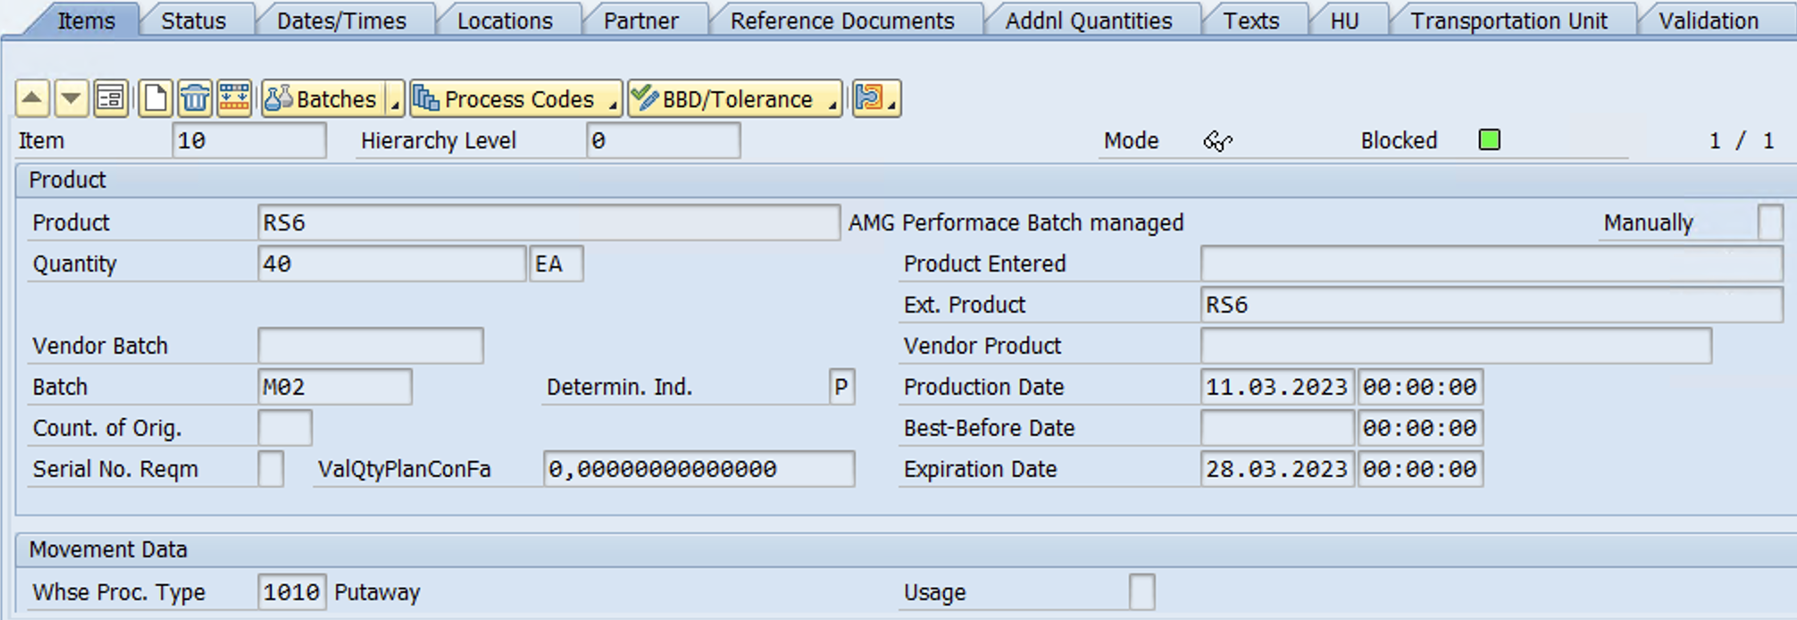
Check IBD in EWM – Batch & Expiration date
www.anubhavtrainings.com

Slide 18
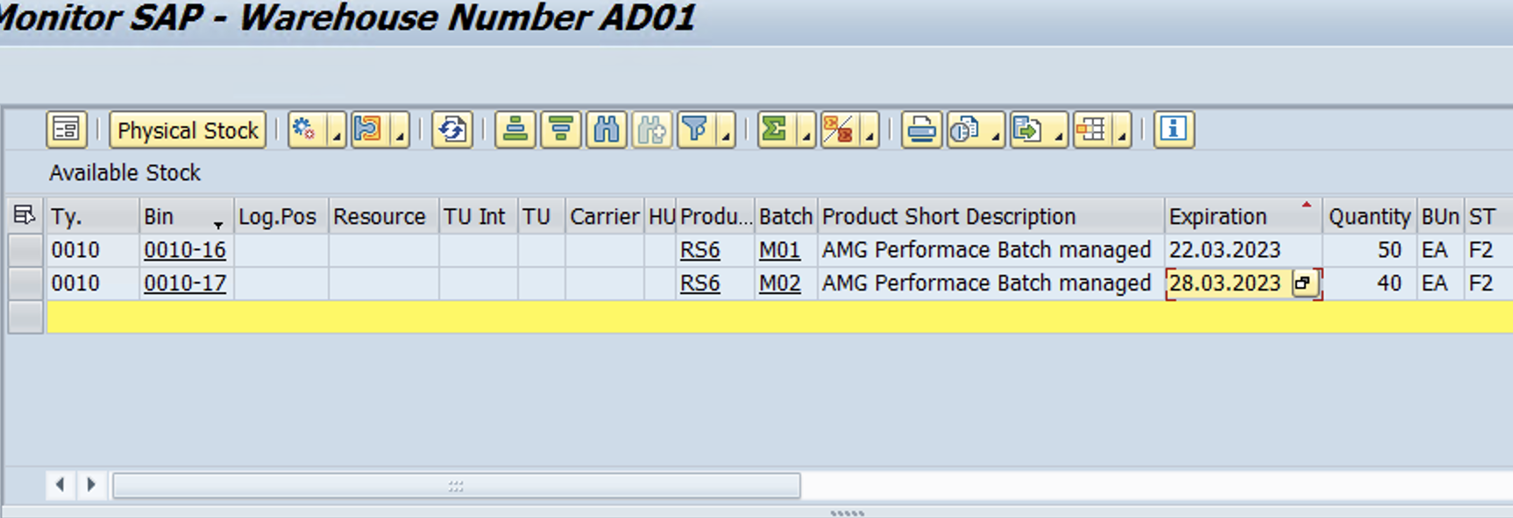
Stock available in batches – Warehouse Monitor
www.anubhavtrainings.com

Slide 19
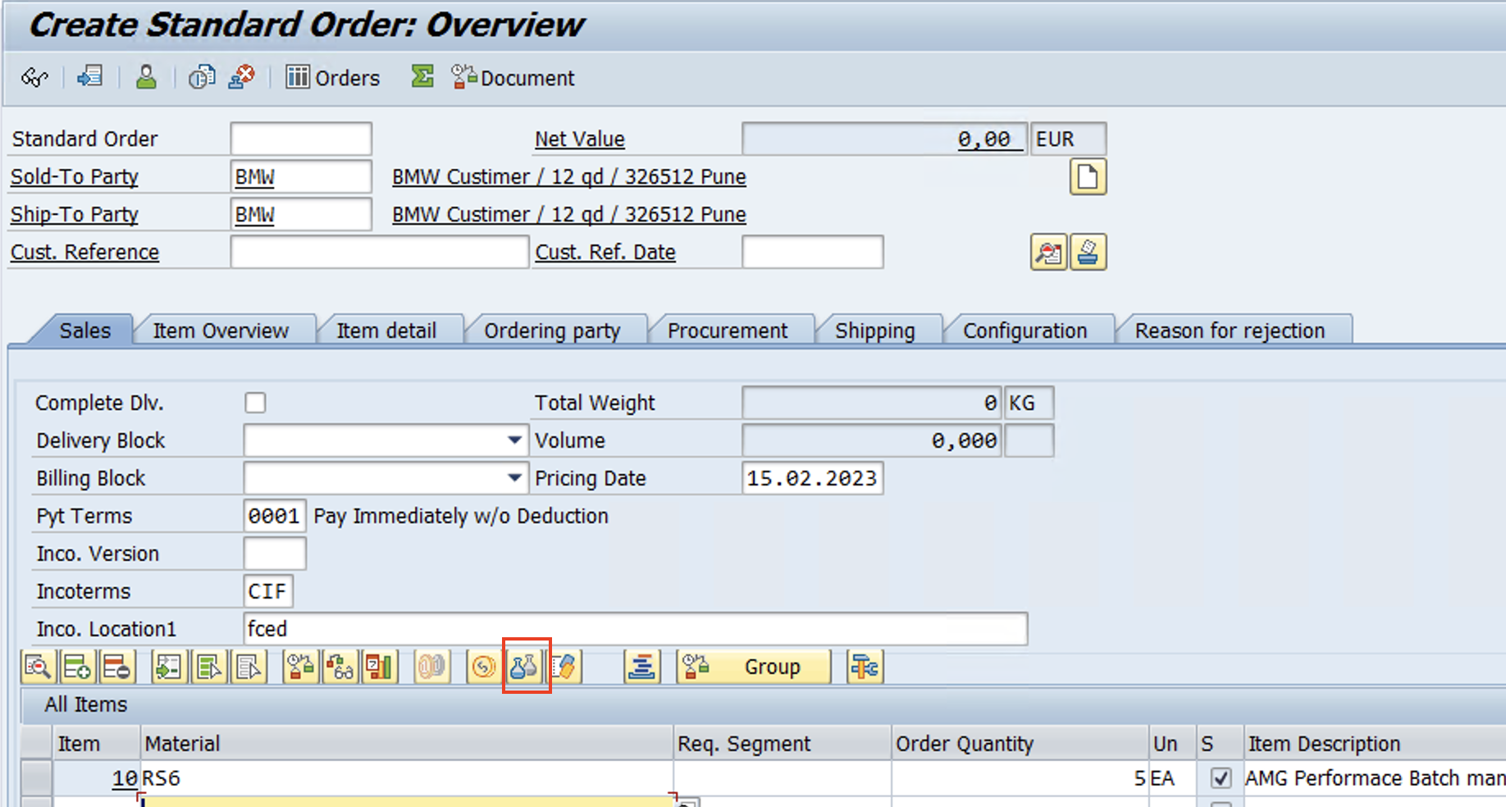
Test Case – Batch Selection Criteria (Outbound)
Scenario – While Picking WT system should check the batch selection criteria
Create Sales order – Click on Batch determination
www.anubhavtrainings.com

Slide 20
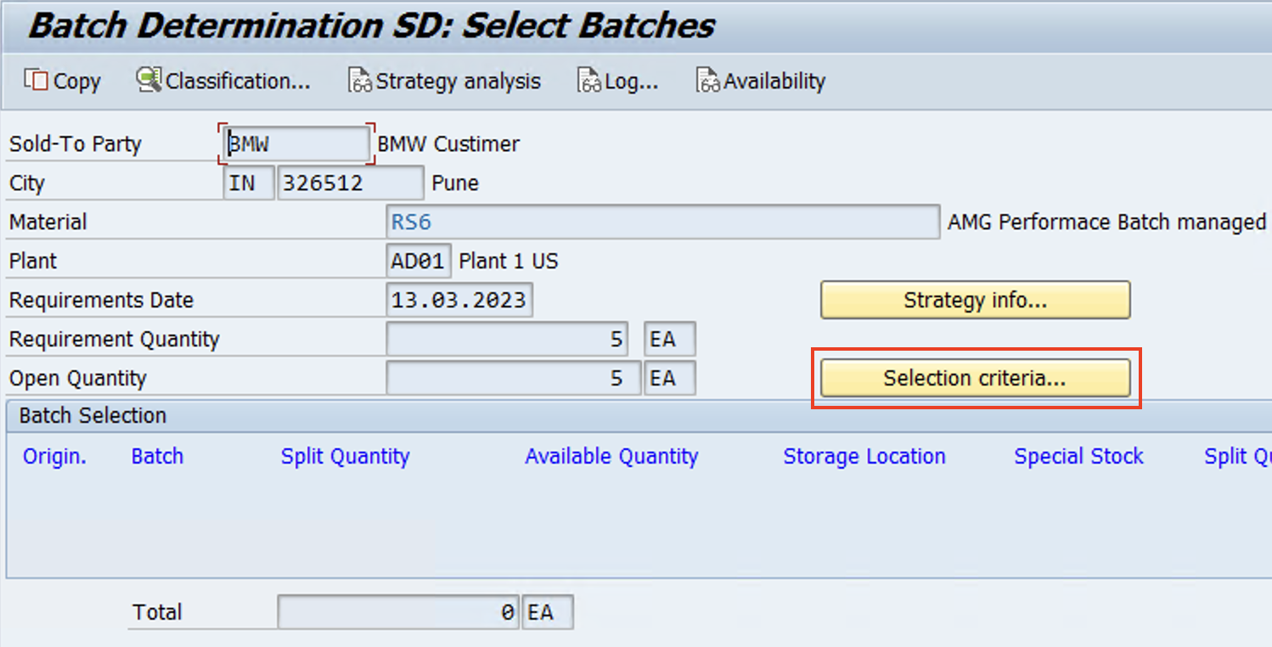
Click on Create

Slide 21
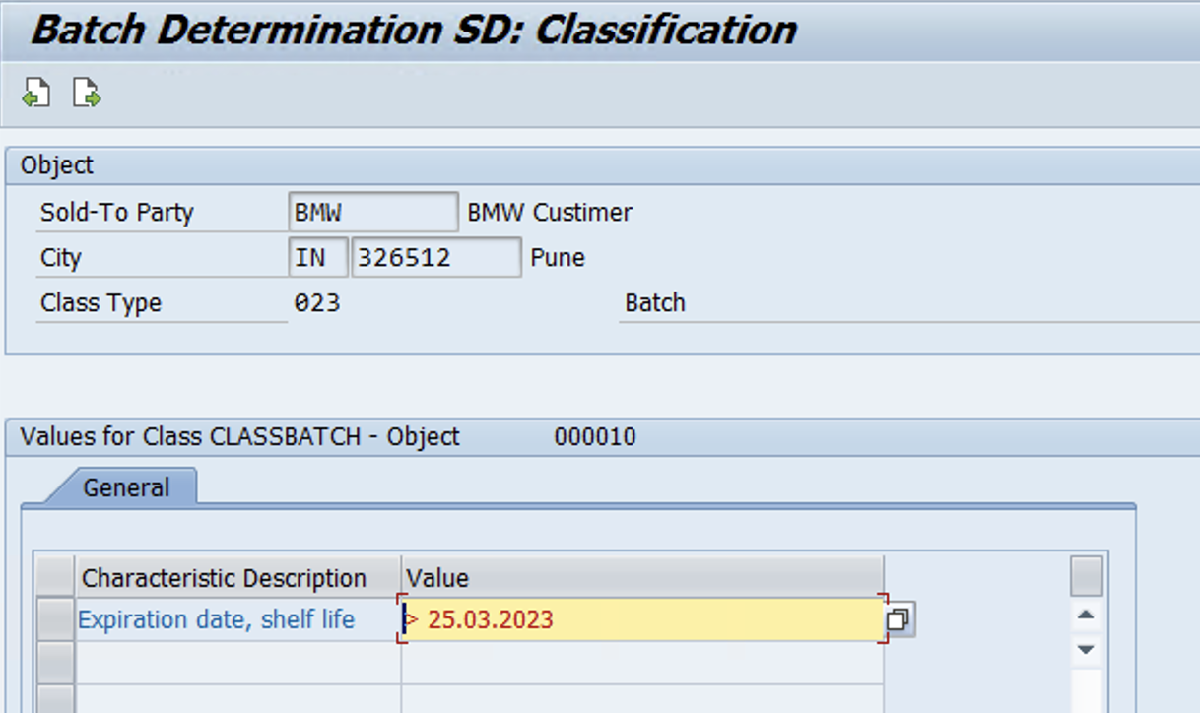
Enter date > Back > Press F5 > Create Sales Order

Slide 22
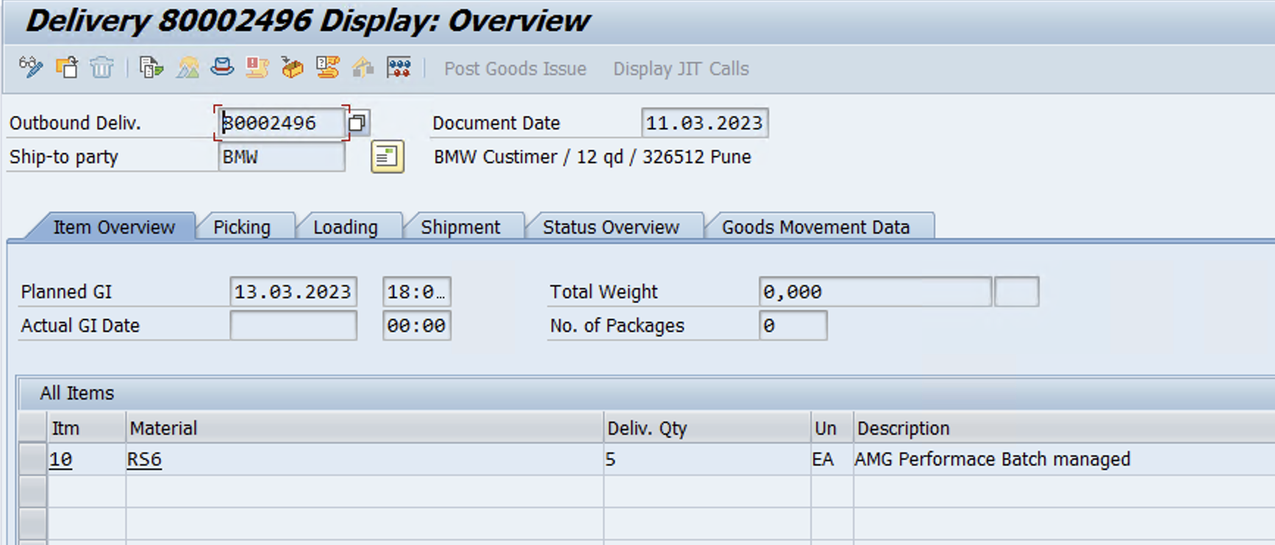
Create Outbound delivery
www.anubhavtrainings.com

Slide 23
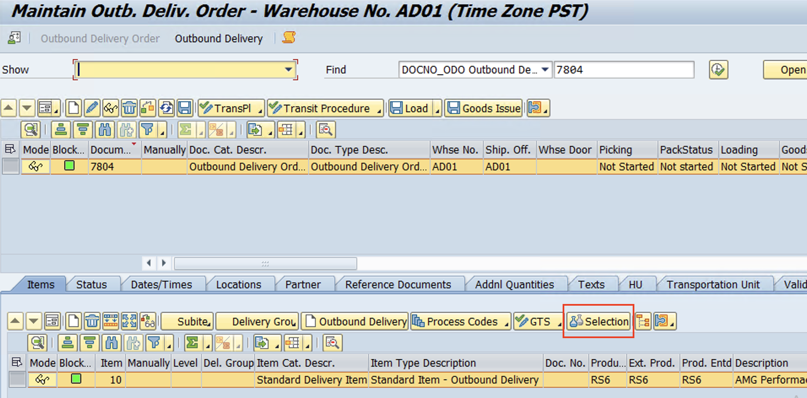
Delivery distributed to EWM
www.anubhavtrainings.com

Slide 24
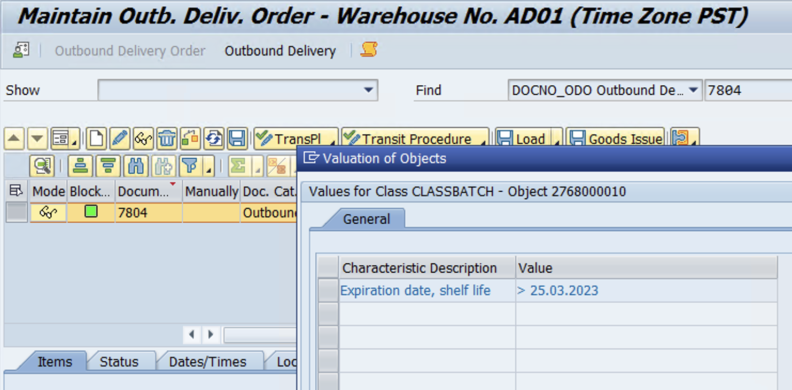
Batch selection criteria copied from Sales Order
www.anubhavtrainings.com

Slide 25
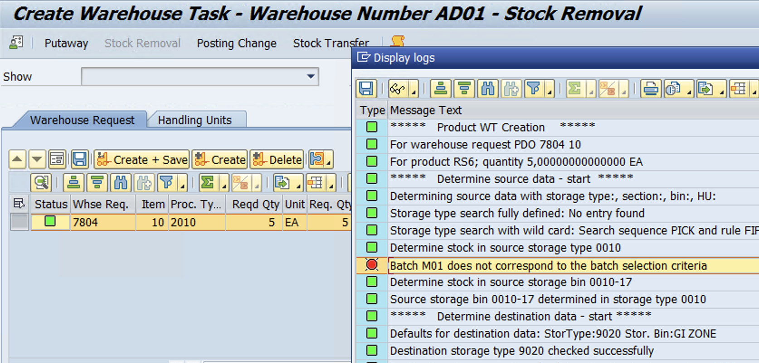

Slide 26
Stock in Warehouse Monitor
www.anubhavtrainings.com

Slide 27
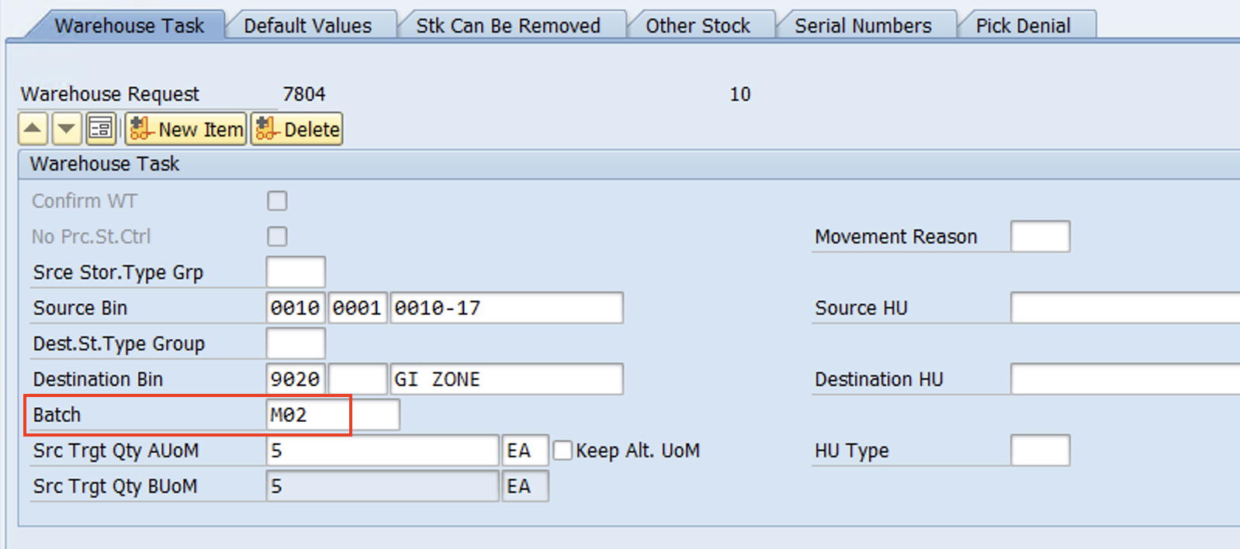
Batch M02 determined by System as per Batch selection criteria
WT Confirmed!
www.anubhavtrainings.com

Slide 28
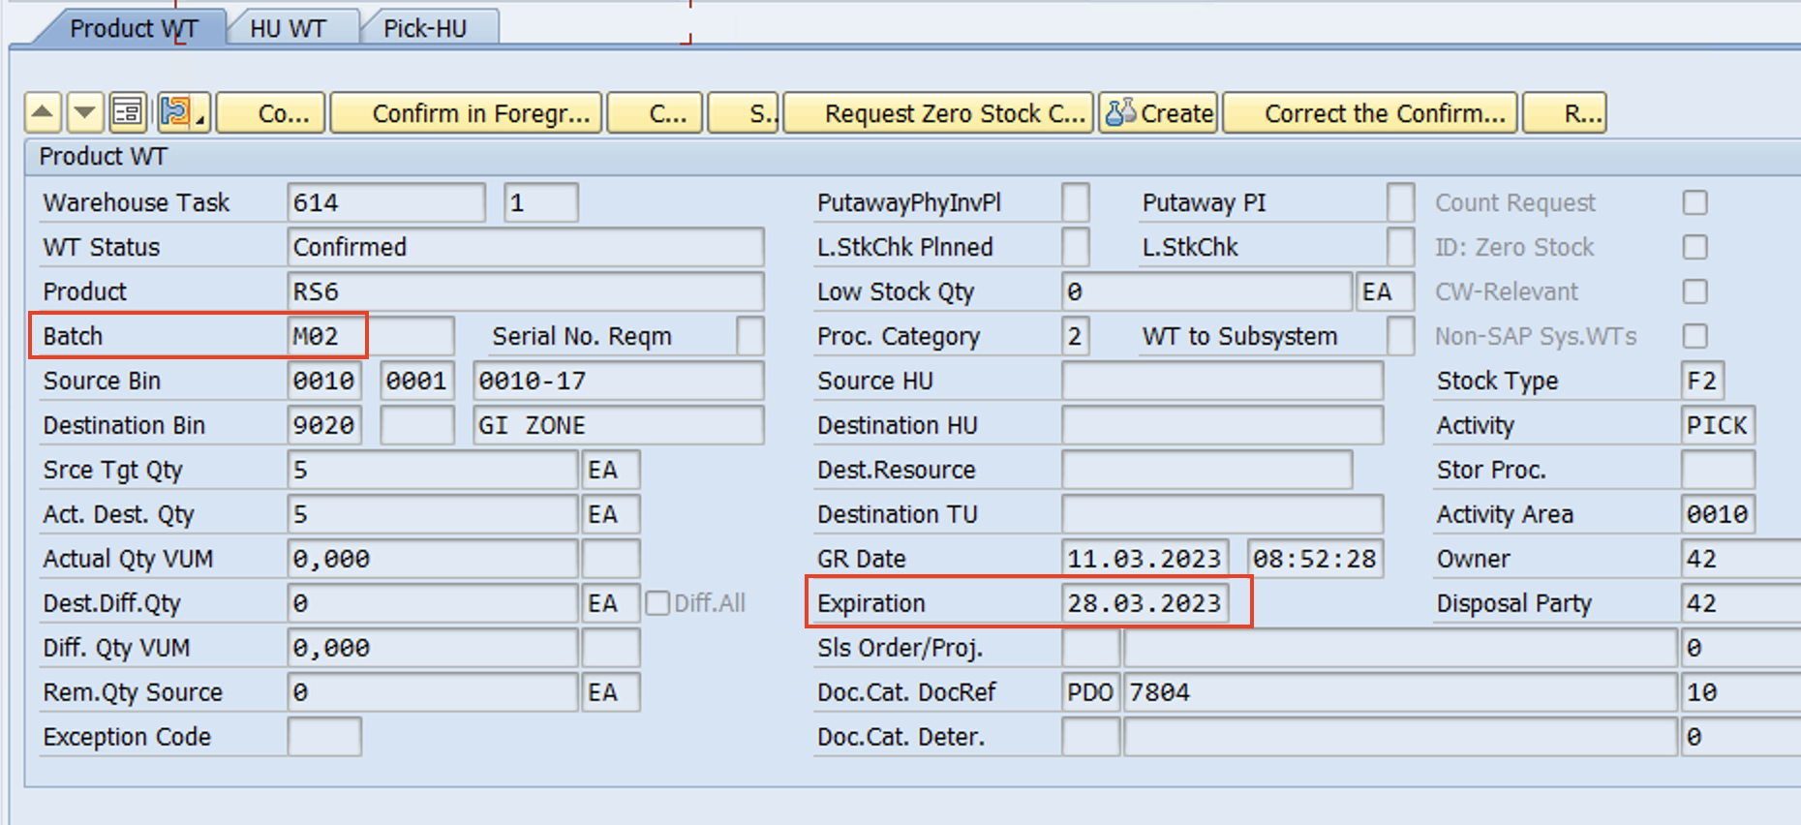
WT Confirmed!

Slide 29
EWM Exception Codes
The exception code basically describes an Exception situation in the warehouse. This Exception situation occurs, for example, if data that the system returns does not match up with the actual situation in the warehouse. You can use a short form of the exception to communicate this to the system.
Example -
While doing Put away WT confirmation, Destination bin is not available for put away due to bin damage/bin renovation so in this case we can use Exception code “CHBD” to change the destination bin

Slide 30
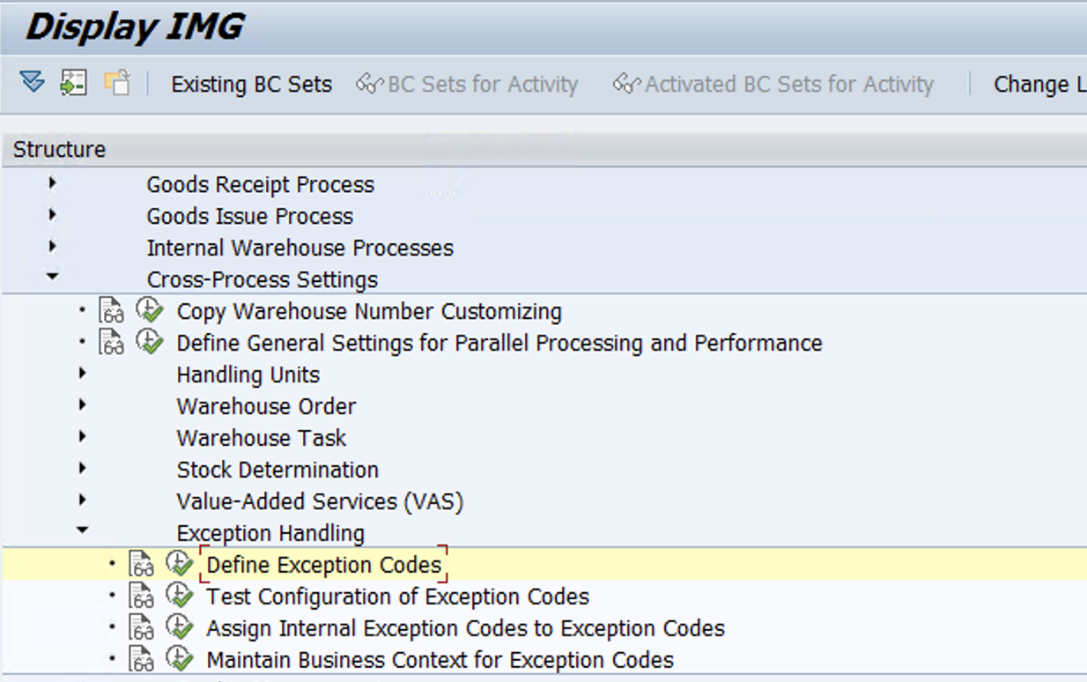
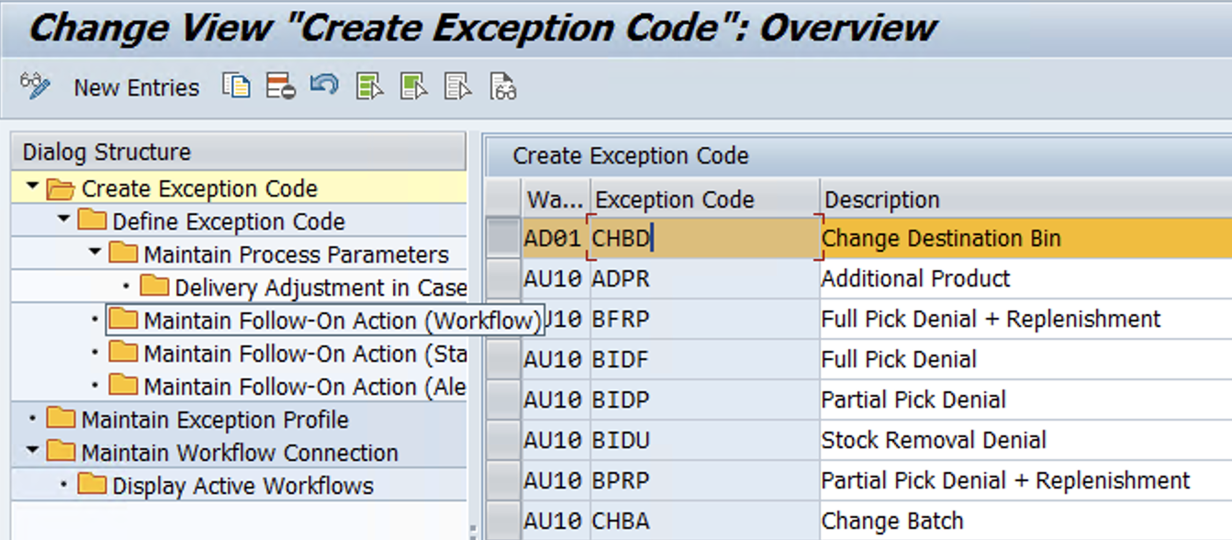
Configuration
Define Exception code

Slide 31
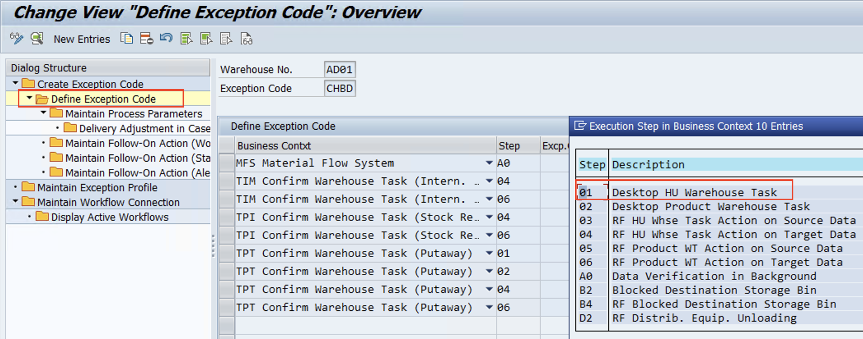
New Entries in Create Exception code > Then go step by step as shown in left side flow ….

Slide 32
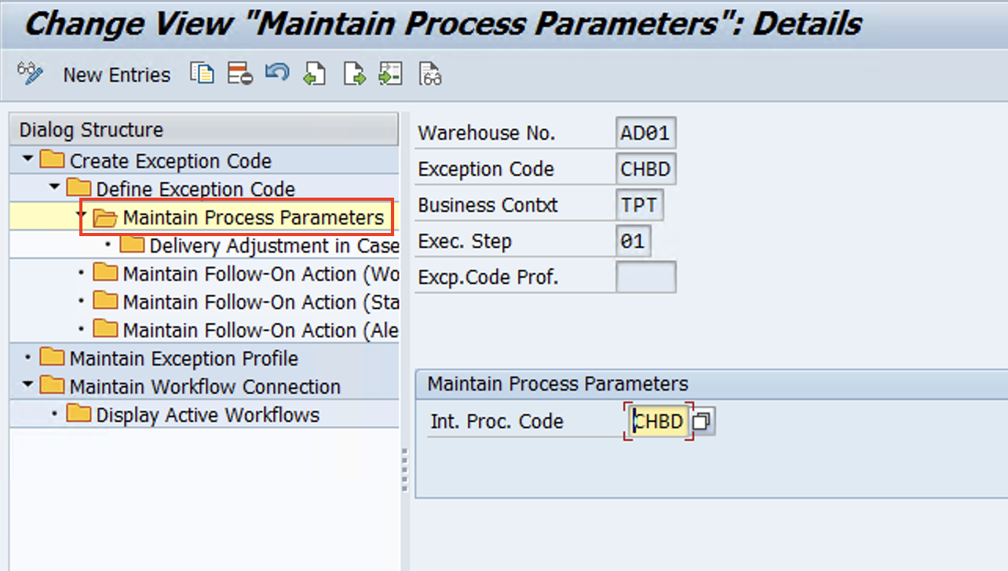
www.anubhavtrainings.com

Slide 33
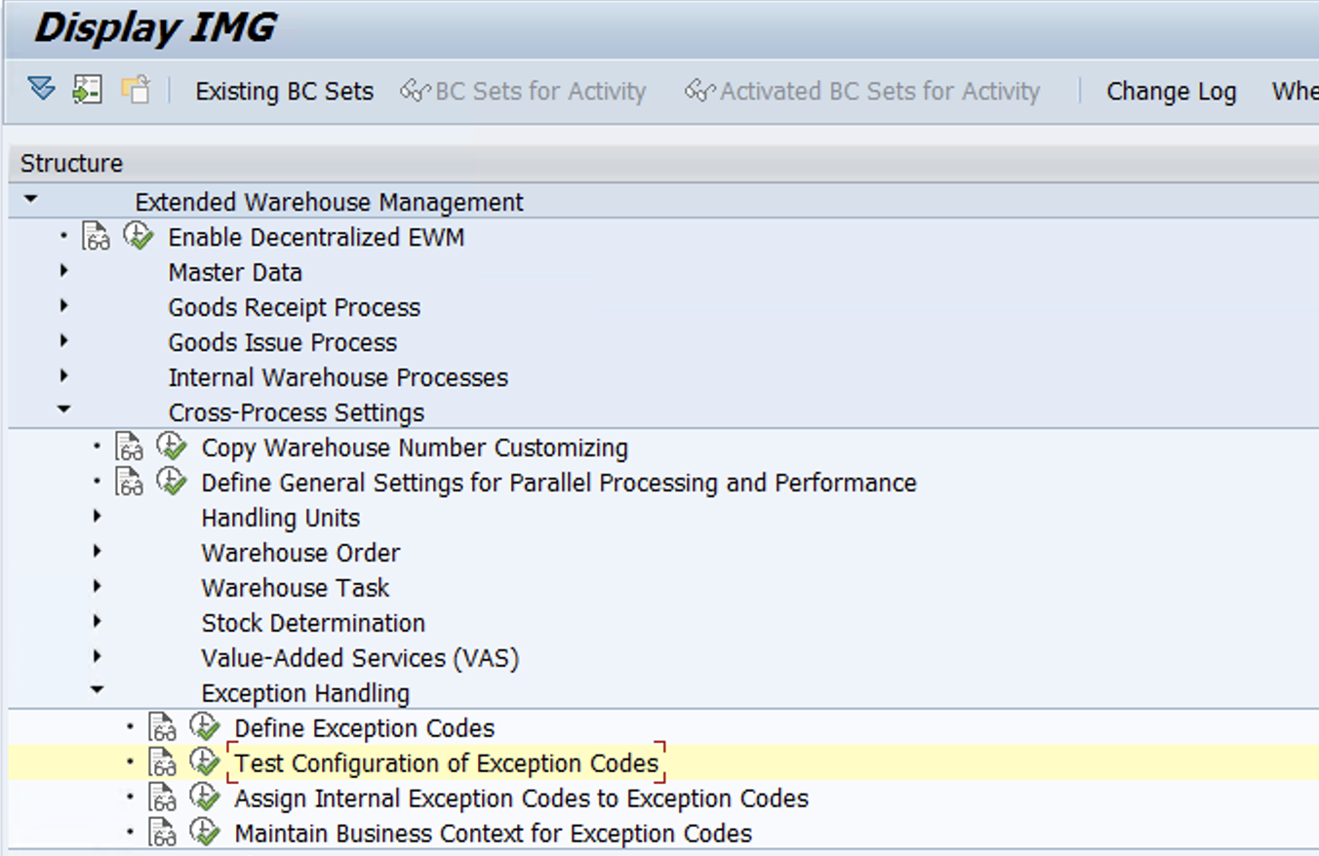
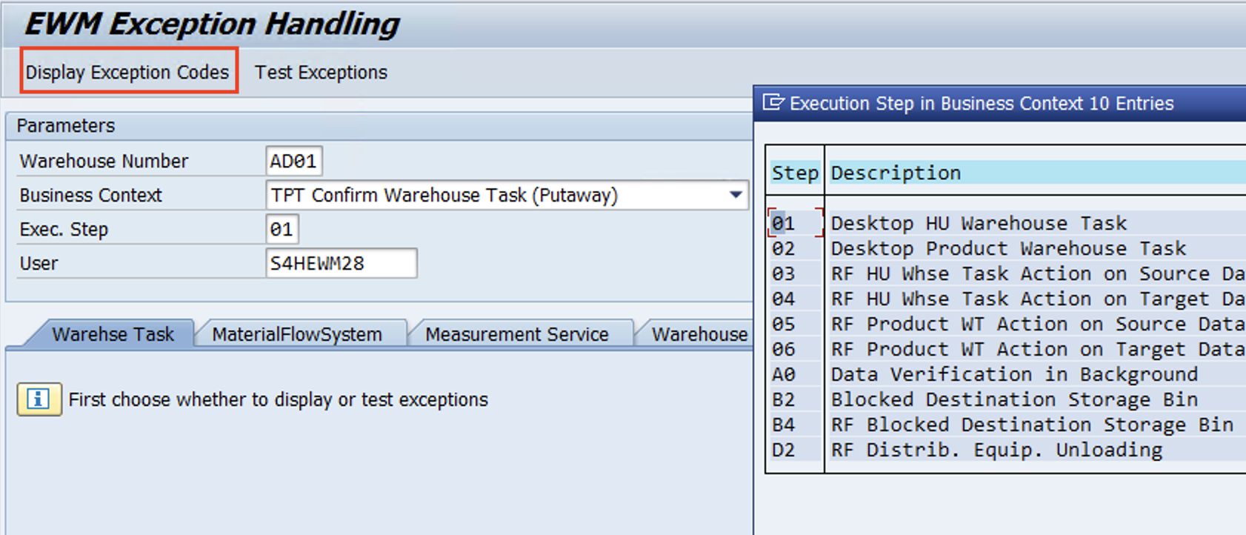
Test Configuration of Exception codes
www.anubhavtrainings.com

Slide 34
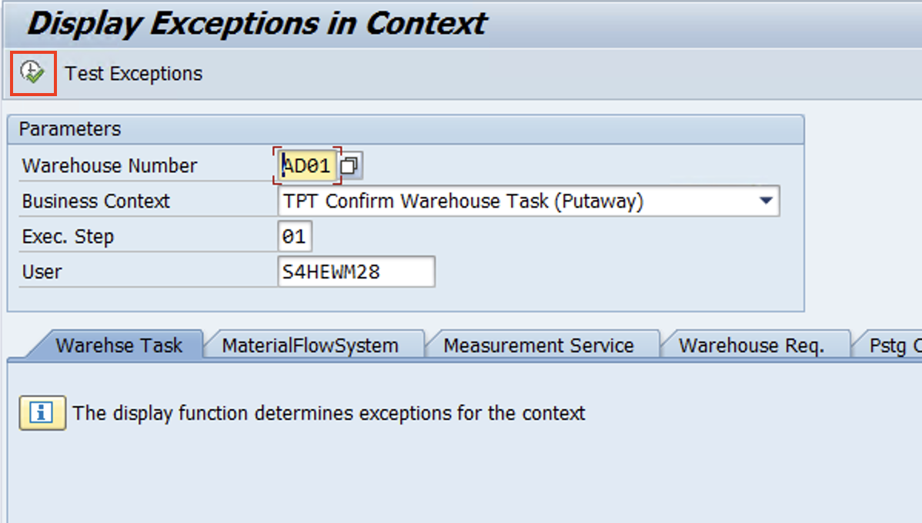

Slide 35
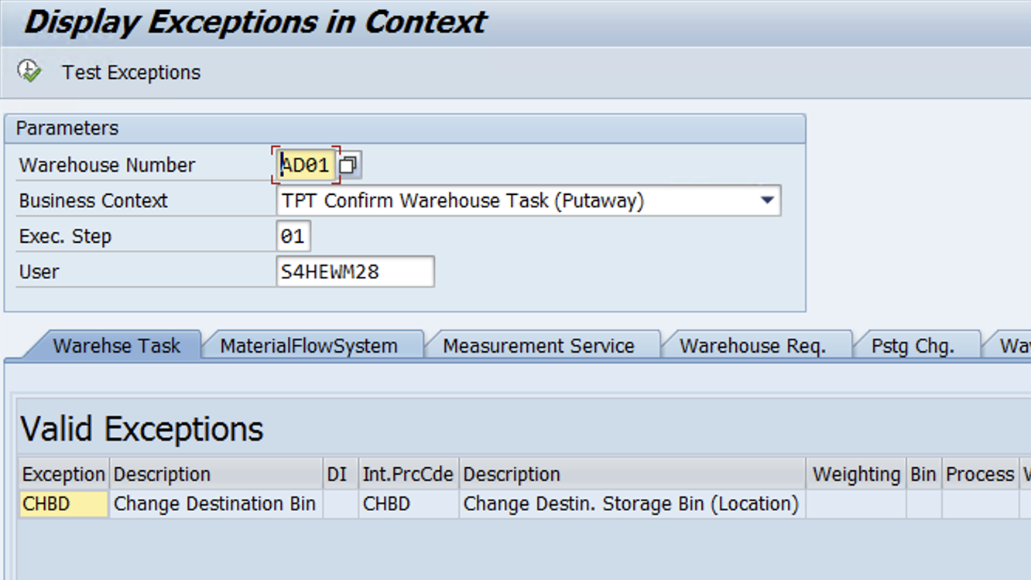
System should show Exception codes as shown in below pic.

Slide 36
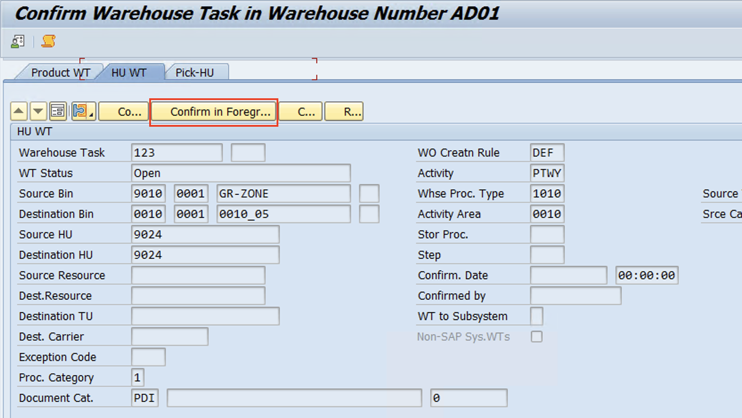
Test Case
Create Putaway WT >> Confirm in foreground

Slide 37
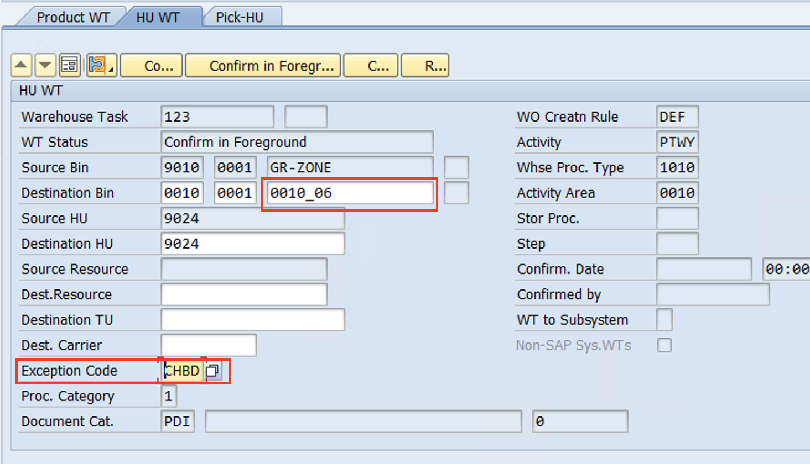
Change the destination Bin & Enter exception code - CHBD
Confirm the WT.
It's Done!
www.anubhavtrainings.com

Slide 38


End of Session
www.anubhavtrainings.com

Slide 39

FEEL FREE TO ASK QUESTIONS

Slide 40

Feedback

Slide 41
THANK
YOU

Slide 42




More from AnubhavTrainings.com

Slide 43






We’re committed to empower you to be
#FutureReady
through powerful training solutions.
We build the workforce of the future.
250+
Corporate Clients
30,000+
Learners Trained
25000+
Learners Placed
FREE WEBINARS
Sign up for free webinars with industry experts every fortnight!
Enroll Now!

Slide 44
FREE WEBINARS
Sign up for free webinars with industry experts every fortnight!
Contact us today!
www.anubhavtrainings.com

